Slide 1
Agenda 3-19
Grades will be shared tomorrow, the TEST helped many of you!
BW – Define
CW – Notes (remember to summarize key information)
HW – 7 Regents Questions and an EQ Paragraph
QOTD – “Hunger makes a thief of any man.”
Pearl S. Buck

Slide 2
Unstable New Democracies
After WWI Fall of kingdoms, empires creates new democracies in Europe
People have little experience with representative government
Frequent changes in government create instability

Slide 3
The Weimar Republic
Weimar Republic—democratic government formed in 1919 has serious weaknesses
Inflation Causes Crisis in Germany
Value of German currency falls dramatically
Attempts at Economic Stability
American loans help revive German economy
Efforts at a Lasting Peace
Germany and France sign treaty pledging no more war
(how well did that work out? Hmmmm….)

Slide 4
Financial Collapse
A Flawed U.S. Economy
Weaknesses in American economy cause serious problems around the world
The Stock Market Crashes
Stock prices too high, people buy stocks on credit
Investors sell stocks, prices fall
On October 29, 1929, stock market collapses as
prices plummet

Slide 5
A Global Depression
Great Depression—business slump of 1930s, bank failures, loss of savings, unemployment
Effects Throughout the World
American economic problems create problems in other countries
World trade falls sharply
US Loans stop, no more investment

Slide 6
The World Confronts the Crisis
Britain Takes Steps to Improve Its Economy
British voters elect coalition government, avoids political extremes
Government brings about slow, steady economic recovery
France Responds to Economic Crisis
France has more self-sufficient economy
Preserves democracy in spite of economic troubles

Slide 7
Fascism
Emphasizes nationalism and loyalty to authoritarian leader
Facist governments came to power in Germany, Italy, and Spain due to the severe economic and social problems that existed in Europe after WWI.

Slide 8
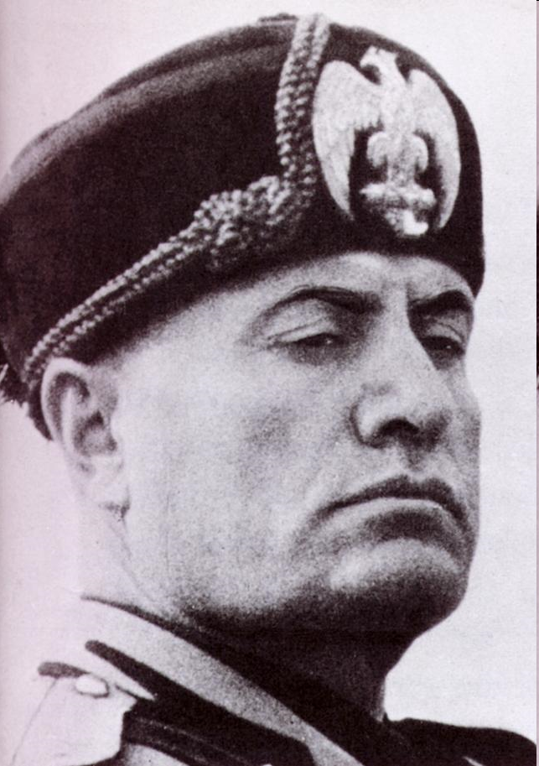
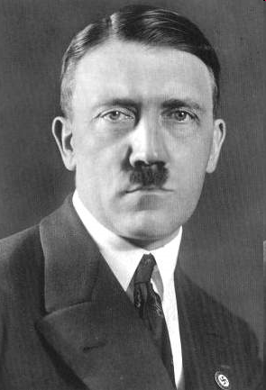
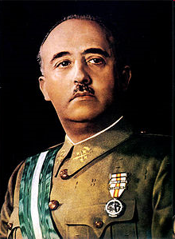
Benito Mussolini; Italy
Adolf Hitler; Germany
Francisco Franco; Spain

Slide 9
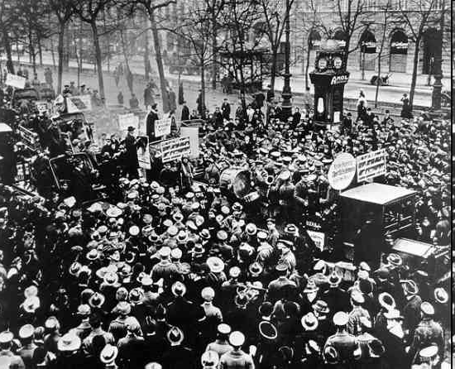
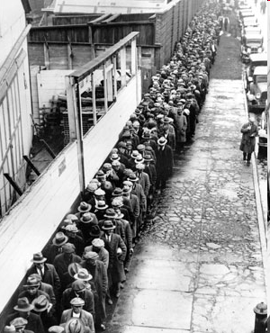

Slide 10
Fascism’s Rise in Italy
Mussolini Takes Control
• Fascist Party leader, Benito Mussolini, promises to rescue Italy
Italian king puts Mussolini in charge of government
Mussolini controls politics and economy in Italy

Slide 11
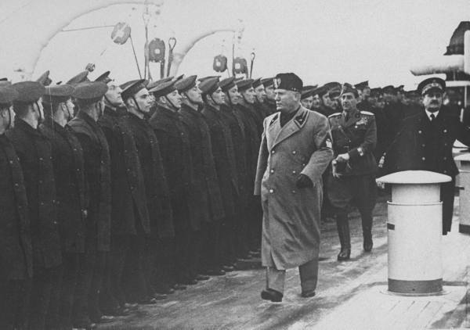
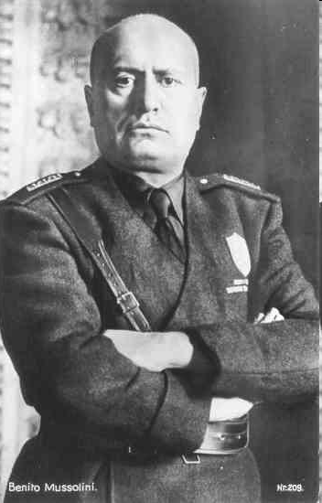
Mussolini and the Fascist Party

Slide 12
NAZI’S!!!
The Rise of the Nazis -German brand of fascism
Hitler’s New Power
• Hitler is named chancellor
• Turns Germany into totalitarian state
• Uses brutal tactics to eliminate enemies
• Nazis take command of economy
•

Slide 13
Hitler
Mein Kampf—Hitler‘s book promoted German superiority
Hitler believes that Germany needs lebensraum, or living space
Germans turn to Hitler when economy collapses

Slide 14
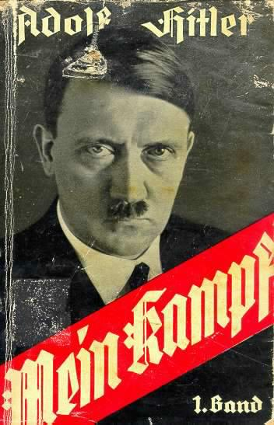
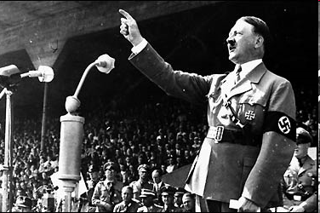

Slide 15
World Is Divided
Most of eastern Europe falls to dictators
Only Czechoslovakia retains democratic government
World splits into two camps—democratic and totalitarian/Fascist

Slide 16
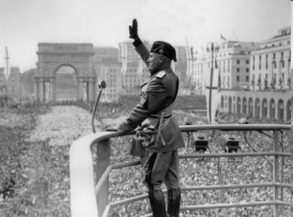
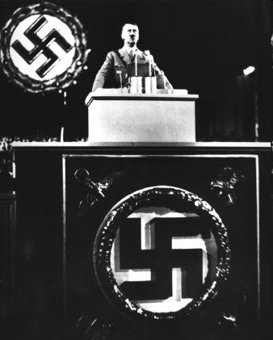
Fascist leaders came to power in Italy and Germany because they exploited economic hardships to gain support.

